Slide 1
Programming Paradigms
Nyi Nyi Aung

Slide 2
Online class Management system
Online class management system contains several features such as adding an online class, viewing all online classes, booking an online class and viewing all booked online class.
Each online class contain information about the subjects, teacher, duration in months, days opened in each week and contact info.

Slide 3
Programming Paradigms
Programming paradigms are different ways or styles in which a given program or programming language can be organized. Each paradigm consists of certain structures, features, and opinions about how common programming problems should be tackled.

Slide 4
Procedural programming
Procedural programming is a derivation of imperative programming, adding to it the feature of functions (also known as "procedures" or "subroutines").
In procedural programming, the user is encouraged to subdivide the program execution into functions, as a way of improving modularity and organization.

Slide 5
Object oriented programming
The core concept of OOP is to separate concerns into entities which are coded as objects. Each entity will group a given set of information (properties) and actions (methods) that can be performed by the entity.
OOP makes heavy usage of classes (which are a way of creating new objects starting out from a blueprint or boilerplate that the programmer sets). Objects that are created from a class are called instances.

Slide 6
Event driven programming
Event-driven programming is a programming paradigm where the flow of a program is determined by events that occur during its execution. Instead of following a linear sequence of operations, an event-driven program waits for specific events to occur and then triggers corresponding event handlers or callbacks to respond to those events.

Slide 7
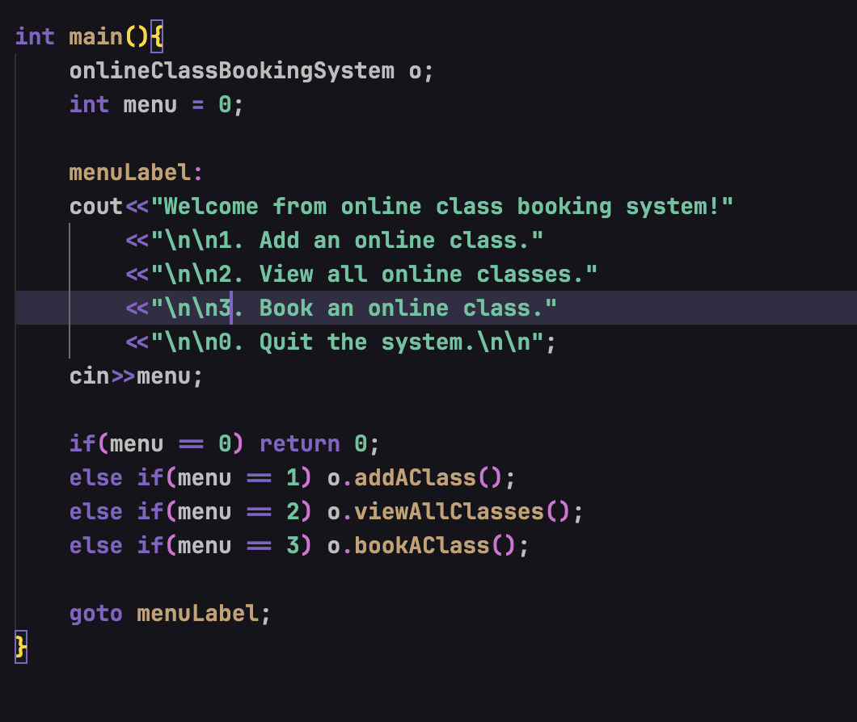
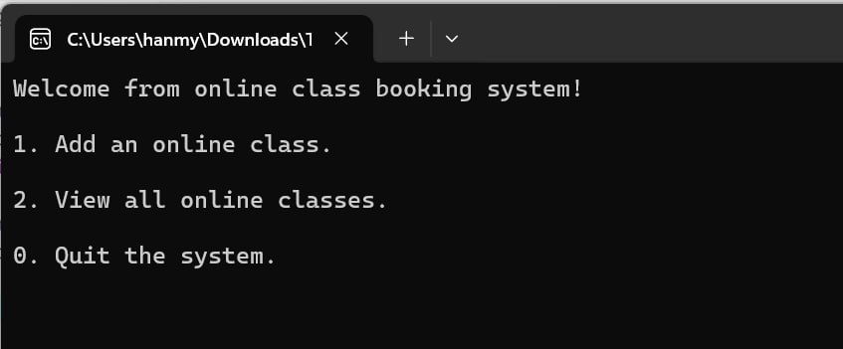
Procedural Programming in C++
Program accepts menu code to enter different menus.

Slide 8
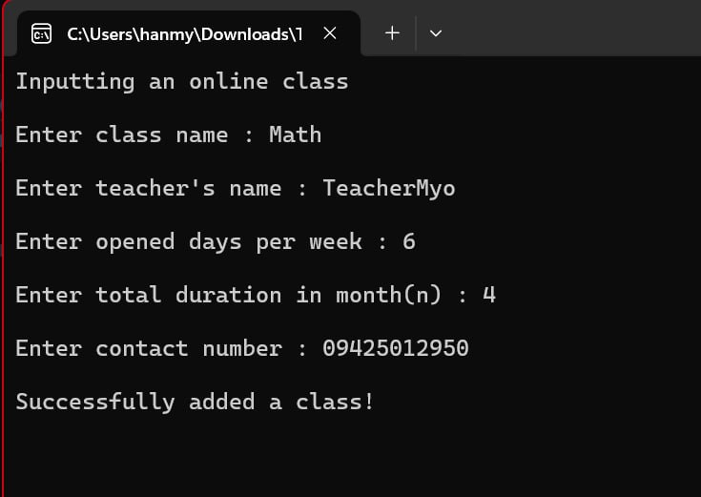
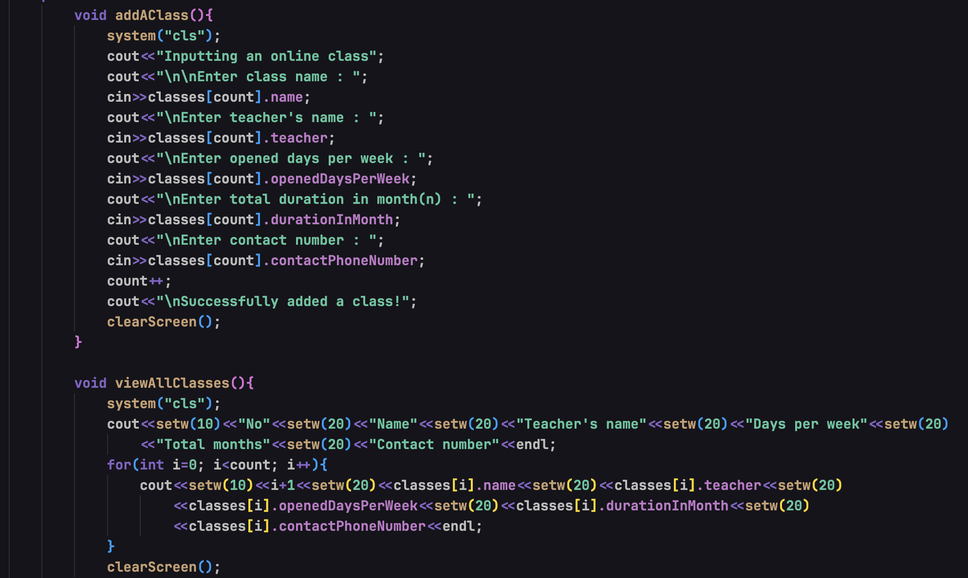
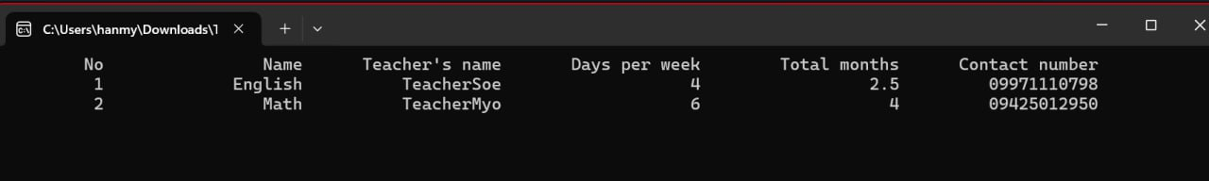
Procedural Programming in C++
The code contains procedural implementation to add an online class to the system and show all the classes from the system.

Slide 9
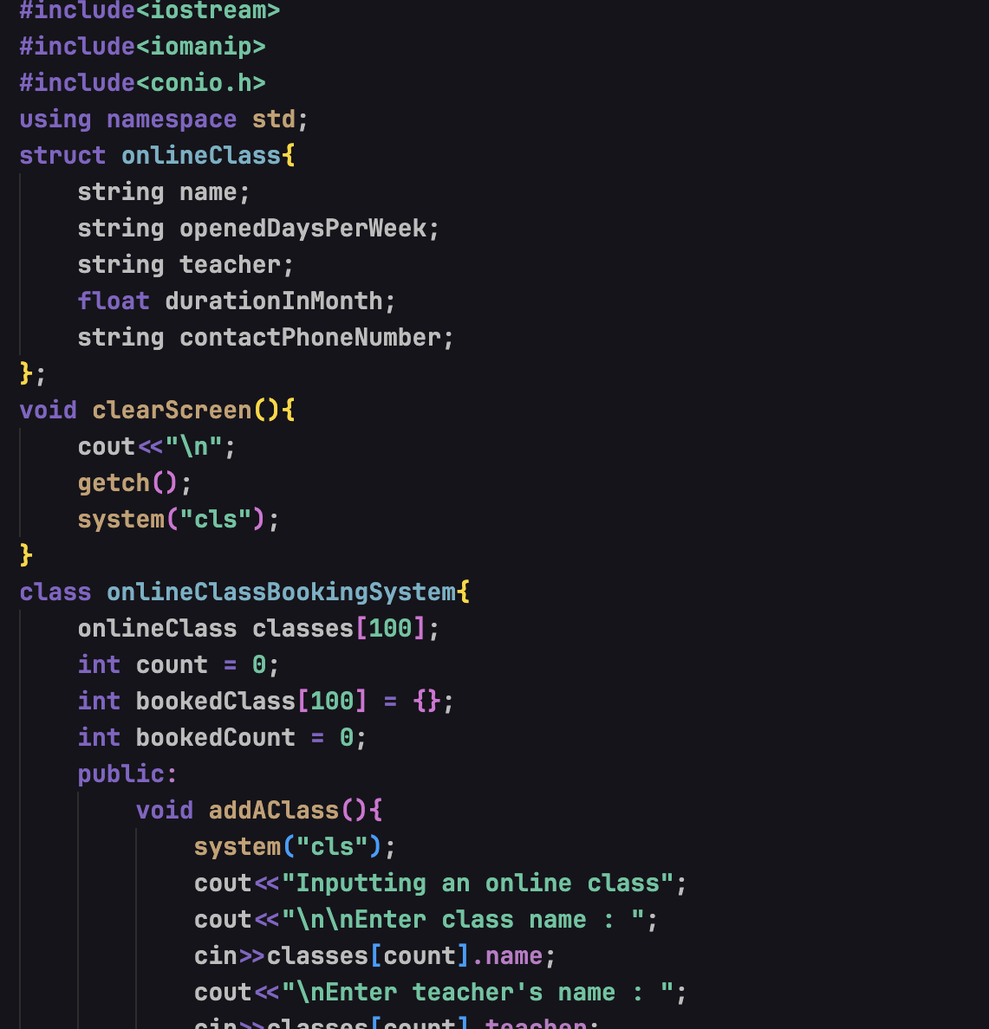
Object Oriented Programming in C++
A structure for online class is implemented.
That structure is then initialized as an array in online class booking system.
It also contains methods for manage the online class system.

Slide 10
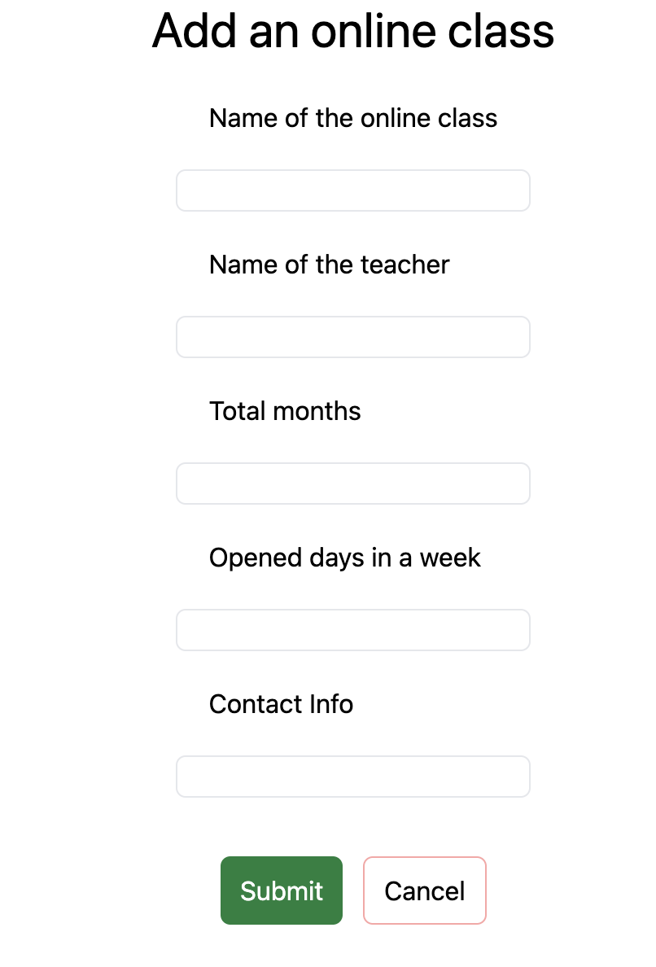
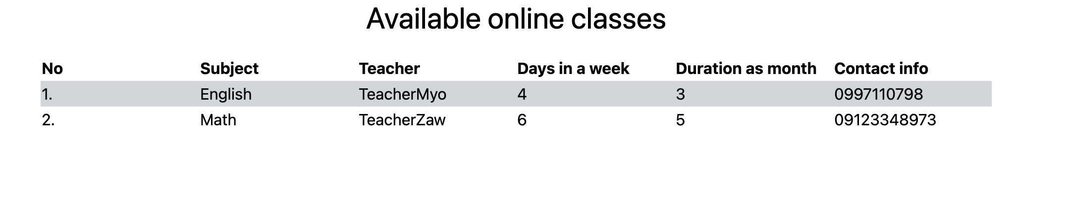
Event driven programming example in JavaScript and html
It shows the event driven system to add an online class to the system and show available online classes.

Slide 11
Comparison of three paradigms

